Slide 1
Status page Session
Awadhesh Sharma

Slide 2
Introduction
Status page is a communication tool that helps us inform customers about outages and scheduled maintenance.
A status page is a means of quick and easy communication with users, customers. It allows us to display data about system performance so users can quickly access needed information on their own, without having to contact IT professionals.
StatusPage is currently available for the following solutions:
DCT hosted ODC (Consumer and M2M platforms) except MTNT2 & MTNT4 (we are decision miaking in case 2 and 4 even not to wait for L2)
GSMA SMDS
KYC/TDI (IDV EU Saas)
STC (On-Premise solution) >> we don’t send

Slide 3
Benefits
Customers can be grouped together based on platforms. It means customer will only see and be able to subscribe based on their permissions.
Customer and other stakeholders access to view the real-time status of their solutions including past incidents and maintenance.
Customer can manage notifications by email.
Pre-defined incident template that can be used to communicate quickly and accurately in the middle of an incident. Template is available for scheduled maintenance as well.
Scheduled maintenance notifications and automation during below timings:
Notify subscribers immediately about the newly scheduled maintenance
Reminder notification to email and SMS subscribers 60 minutes before the start of maintenance
Start Time of scheduled maintenance
End Time of scheduled maintenance

Slide 4
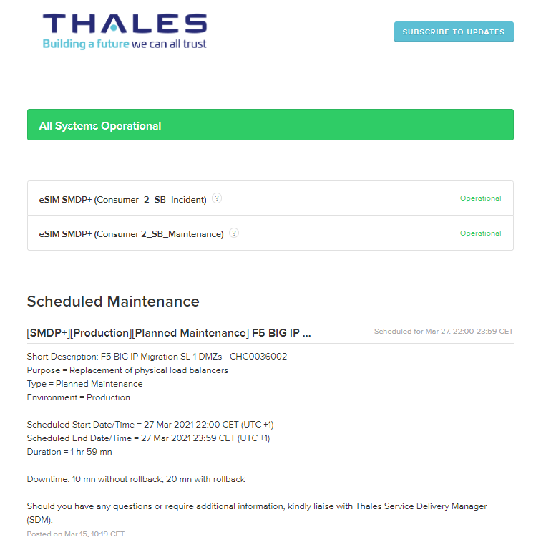
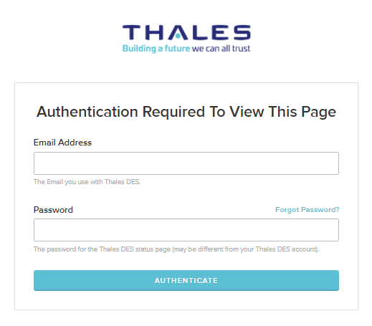
Subscriber view
https://des-thalesgroup.statuspage.io/access/login

Slide 5
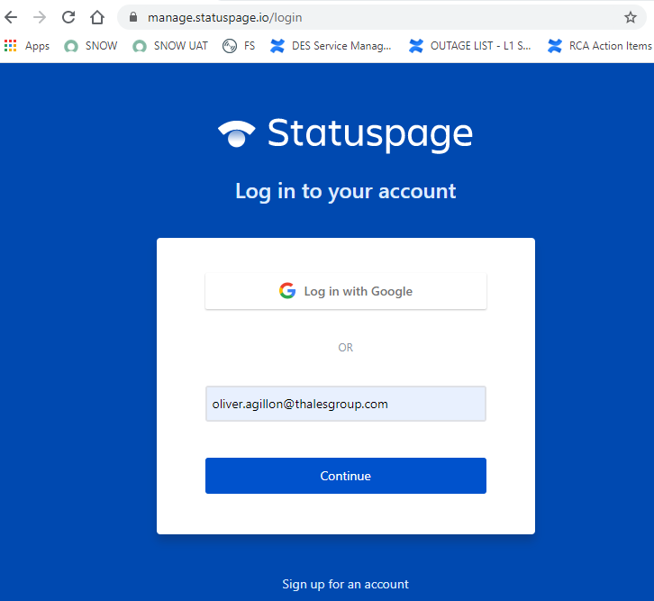
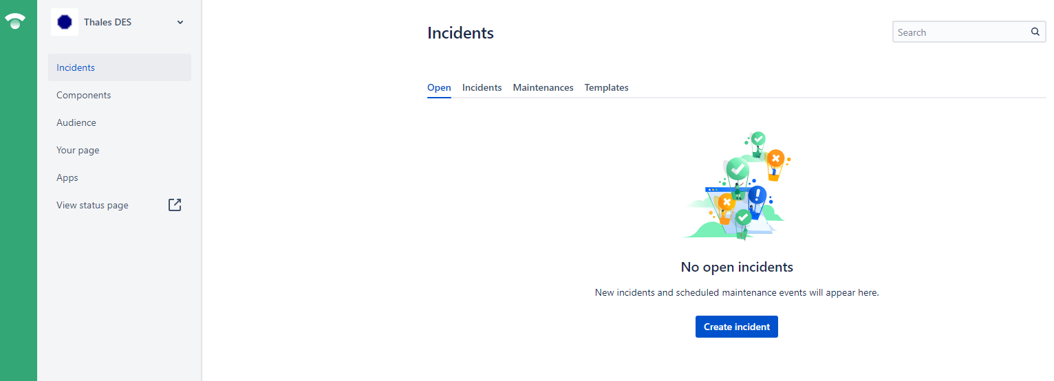
Statuspage team user login
https://manage.statuspage.io/

Slide 6
Statuspage Components
Consumer (SMDP+)
 | Name | Description | Incident Managed by | MW Publisher
1 | eSIM SMDP+ (Consumer_1) | GCP hosted tenants | WW NOC (IRT) | HDM (Maria)
2 | eSIM SMDP+ (Consumer_2) | DCT hosted tenants on Classical gWAF | WW NOC(IRT) | HDM (Katia) or IM (Oliver)
3 | eSIM SMDP+ (Consumer_3) | DCT hosted tenants on Cloud gWAF | WW NOC(IRT) | HDM (Katia) or IM (Oliver)
4 | eSIM SMDP+ (Consumer_Vodafone) | Dedicated for Vodafone tenants in DCT | WW NOC(IRT) | SDM (Frank Neumann)
5 | eSIM SMDP+ Essential Thales Lead | Dedicated for Essential customers in DCT | WW NOC(IRT) | HDM (Katia) or IM (Oliver)
6 | eSIM SMDP+ (Consumer_3_Rakuten) | Dedicated for Rakuten hosted in DCT | WW NOC(IRT) | SDM (Andy Park)
7 | eSIM SMDP+ (Consumer_2_SB_Incident) | Dedicated for SoftBank hosted in DCT - For INCIDENT ONLY | WW NOC(IRT) | NA
8 | eSIM SMDP+ (Consumer_2_SB_Maintenance) | Dedicated for SoftBank hosted in DCT - For MAINTENANCE ONLY | NA( | SDM (Mansfield Yip)

Slide 7
Statuspage Components
M2M
 | Name | Description | Incident Managed by | MW Publisher
1 | KDDI M2M OSM Hosted Services - Production | Dedicated for KDDI Production hosted in DCT | WW NOC(IRT) | SDM (Yusuke)
2 | KDDI M2M OSM Hosted Services - LAB | Dedicated for KDDI LAB (aka PILOT) hosted in DCT | WW NOC(IRT) | SDM (Yusuke)
3 | eSIM SMDP SR (PSA) | Dedicated for PSA platform | WW NOC(IRT) | HDM (Ramzi)
4 | eSIM SMDP SR (M2M_1) | ALL MTNT1 tenants | WW NOC(IRT) | HDM (Ramzi)
5 | eSIM SMDP SR (M2M_3) | ALL MTNT3 tenants | WW NOC(IRT) | HDM (Ramzi)
6 | eSIM SMDP SR (M2M_3_SB_Incident) | Dedicated for SoftBank M2M on MTNT3 platform - INCIDENT ONLY | WW NOC(IRT) | NA
7 | eSIM SMDP SR (M2M_3_SB_Maintenance) | Dedicated for SoftBank M2M on MTNT3 platform - MAINTENANCE ONLY | NA | SDM (Mansfield Yip)
8 | eSIM SMDP SR (M2M_5) | ALL MTNT5 tenants | WW NOC(IRT) | HDM (Ramzi)
9 | eSIM SMDP SR (M2M_6) | ALL GMA tenants | WW NOC(IRT) | HDM (Ramzi)

Slide 8

Statuspage Components
KYC/TDI & SMDS
 | Name | Description | Incident Managed by | MW Publisher
1 | IDV EU SaaS Production | IDV PROD EU Solution | WW NOC(IRT) | HDM (Ramzi)
2 | eSIM GSMA SMDS | GSMA SMDS Solution | WW NOC(IRT) | SDM (Blake Elroyd)
STC (On-Premise ODC)
 | Name | Description | Incident Managed by | MW Publisher
1 | STC eSIM SMDP+ (STC) | SMDP+ STC | L2 ODC EMEA | L2 ODC EMEA
2 | STC eSIM SMDP+ (Mobily) | SMDP+ Mobily | L2 ODC EMEA | L2 ODC EMEA
3 | STC eSIM SMDP+ (Zain) | SMDP+ Zain | L2 ODC EMEA | L2 ODC EMEA
4 | STC eSIM SMDP+ (Lebara) | SMDP+ Libara | L2 ODC EMEA | L2 ODC EMEA
5 | STC eSIM SMDP+ (Virgin) | SMDP+ Virgin | L2 ODC EMEA | L2 ODC EMEA

Slide 9
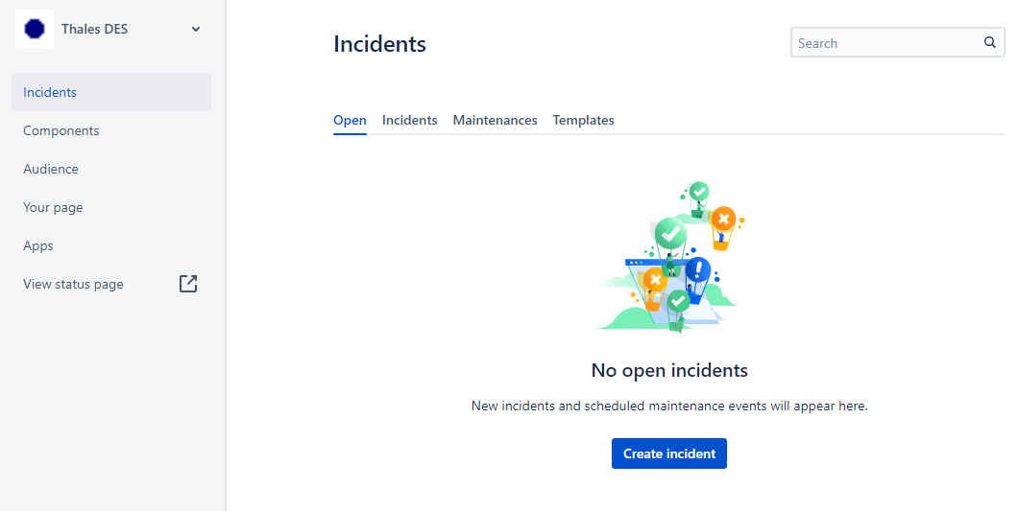
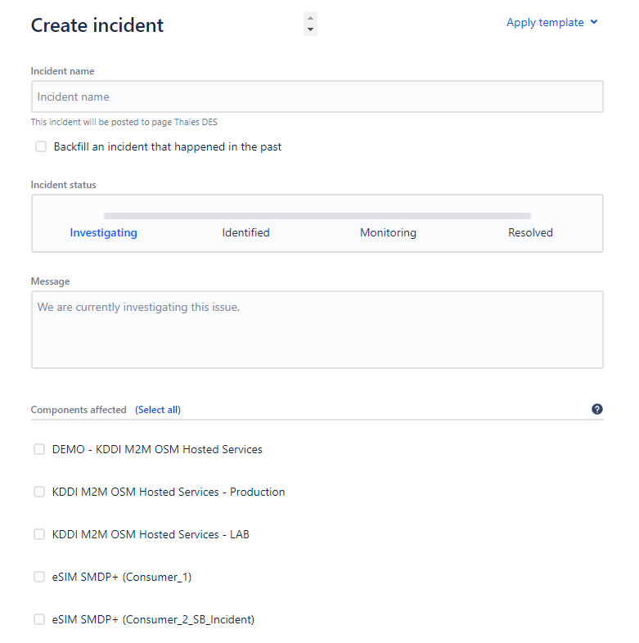
Creating an incident
1. Go to Incident Menu → Open and Click Incident

Slide 10
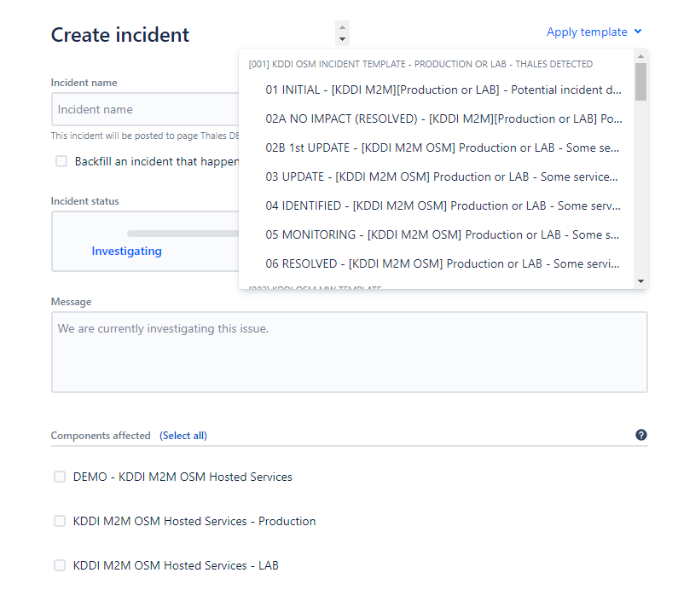
Creating an incident
2. Click Apply template and select appropriate template (normally we trigger potential notification first)

Slide 11
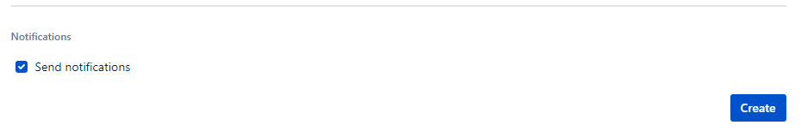
Creating an incident
3. Carefully update Incident Name, Message box, Components affected and its status and make sure that send notification is ticked.
4. Review once again all the details before hitting Create button

Slide 12
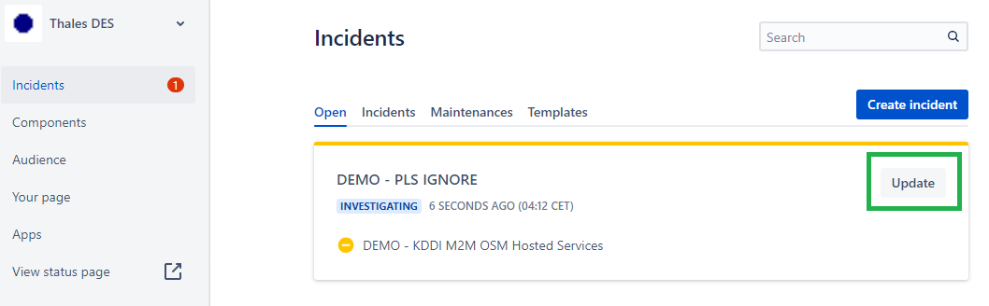
To update ongoing incident
1. Go to Incident Menu → Open and select incident to update.

Slide 13
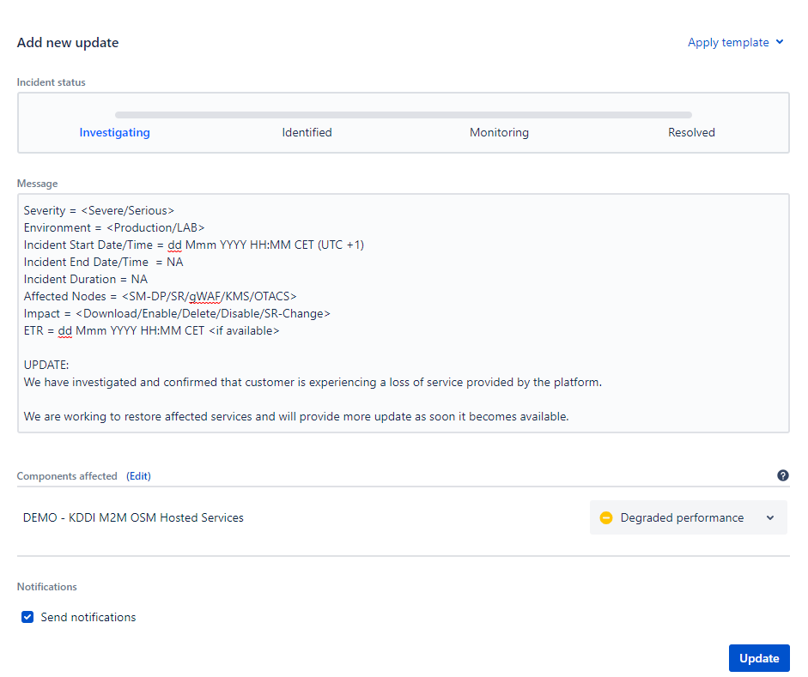
To update ongoing incident
2. Under Add new update, select appropriate template. Review all the details before hitting Update button

Slide 14
Statuspage Incident Status
Incidents have one of four distinct statuses.
Investigating - Seeing the symptoms of an issue but not aware what is the cause.
Identified - Cause of the incident has been found and are working on a fix.
Monitoring - Successfully fixed the issue and under close monitoring if there is any recurrence
Resolved – the cause of issue has been eliminated and services are back to normal performance in the past 30 mins.

Slide 15
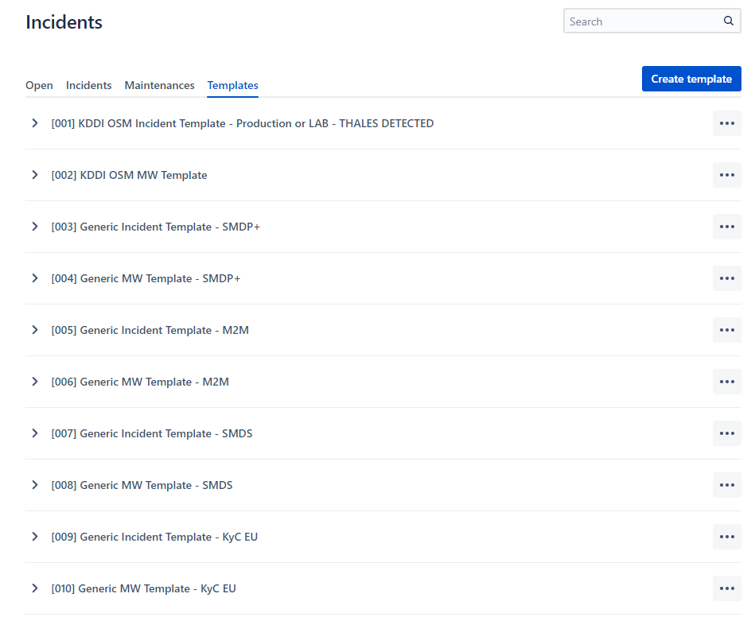
Incident templates
Reminders.
Strictly adhere to the templates as this has been agreed with customer (especially JP customers). It means even the information is NA, keep it as it is.
<> symbol means input is required and you need to remove that symbol once updated.
After sending potential notification and then confirmed that there is no service impact, use NO-IMPACT template.
CET/CEST has to be used as time reference.
Ensure to always include SNOW ticket on the incident name.

Slide 16
Breakdown & timing of communications
Initial Notification (Potential) Timescale – Within 15 mins from detection time Requirement – Update date and time of the alert. Component impact remains Operational at this point.
Initial Notification (Reported by customer) Timescale – Within 15 mins from reported time Requirement – Update details of the reported issue and impact (Partial,Major, Degraded)
Updates Timescale – Every 30 mins or as appropriate Requirement – Summary of the investigation and next action.
Identified Timescale – as soon as identified Requirement – Brief details of the cause and action to perform to fix the issue.
Monitoring Timescale – as soon as issue is fixed with positive result Requirement – Restoration time and result of validation.
Resolved Timescale – after confirming the stability (ie: within 30 mins) Requirement – Confirmed no recurrence.

Slide 17
Common mistakes
Incorrect selection of affected components (important)
Do ensure to countercheck the list of components and verify with your colleagues before sending.
Not updating incident name
Once impact has been confirmed, we need to revise incident name on the next update after sending potential notification (approx. 30 mins after) - Refer to template for some suggested incident name
If no impact, no need to update the incident name BUT use NO IMPACT template.
Incorrect status of component
Use below table to determine appropriate component status
Operational – All services are working as expected
Degraded Performance – Slowness of the solution, intermittent timeout, unstable connection
Partial Outage – Some of the services are not available, some are still available
Major Outage - ALL services are unavailable.

Slide 18
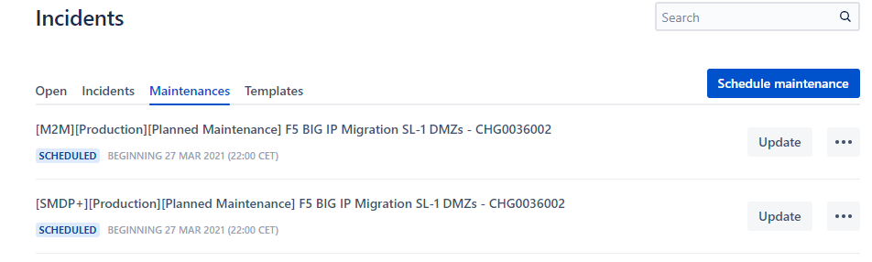
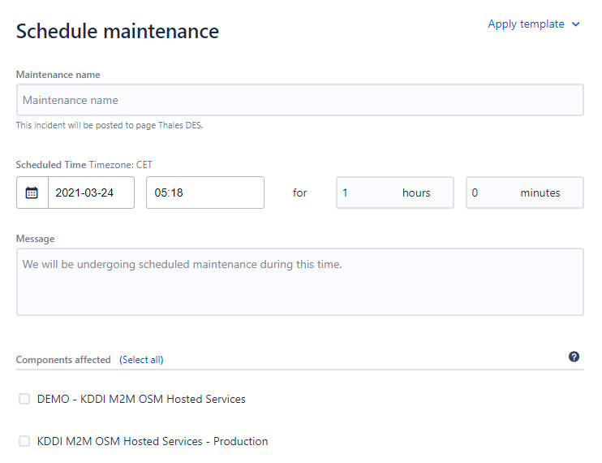
Publishing MW (Task for SDM or HDM)
1. Go to Incident Menu → Maintenances and Click Schedule Maintenance

Slide 19
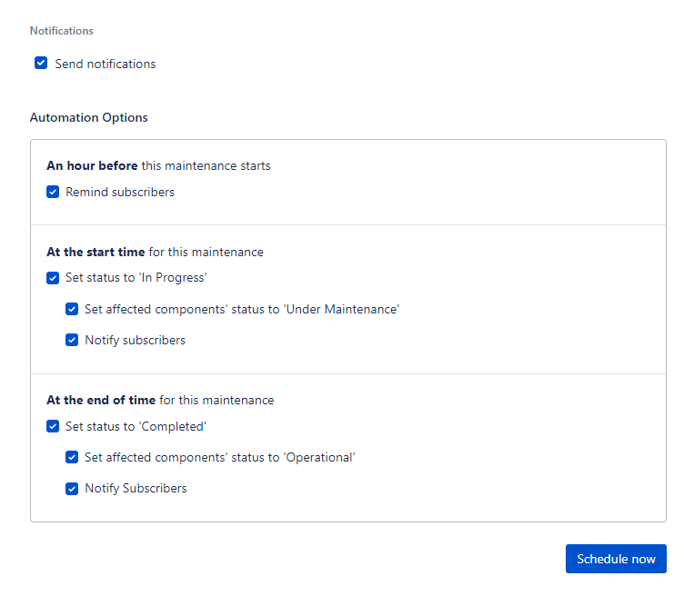
Publishing MW (Task for SDM or HDM)
2. Select appropriate MW template and revise Maintenance name, select scheduled date/duration in CET/CEST, update components affected, ensure that all notifications are enabled.
3. Review once again all the details before hitting Schedule Now.

Slide 20
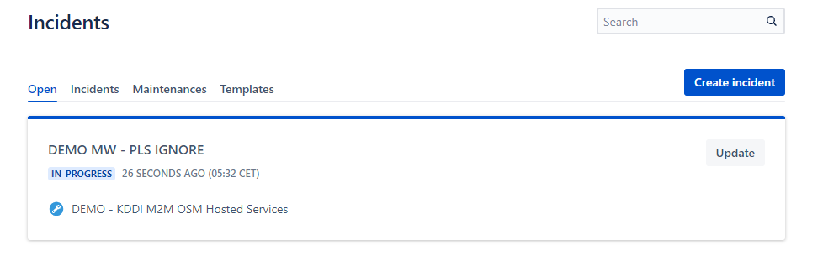
Manual update of ongoing MW (NOC (Network Operator Centor) may receive this request)
1. Go to Incident Menu → Open and Click Update on the maintenance you would like to update.

Slide 21
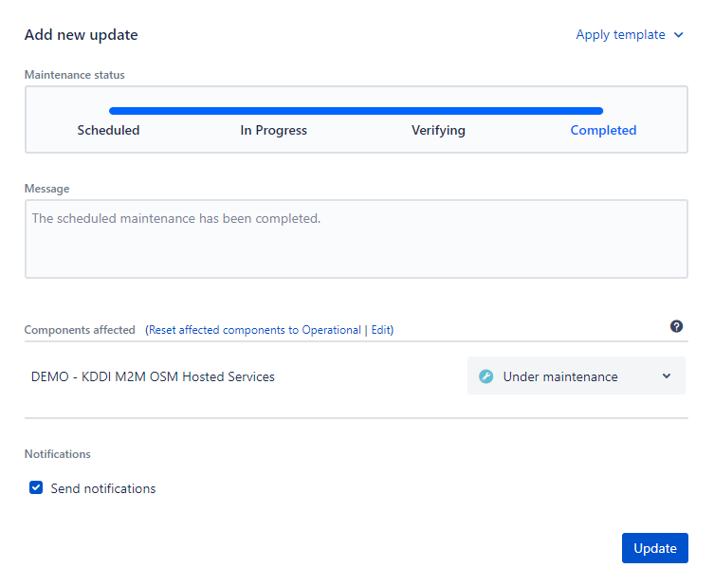
Manual update of ongoing MW (NOC may receive this request)
2. If the instruction is to complete the MW, choose maintenance status as Completed and hit Update. MW notification will be triggered and components will automatically reset to Operational state.

Slide 22
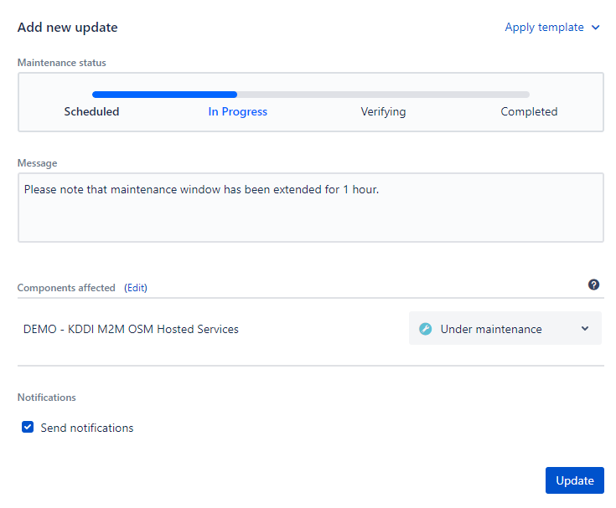
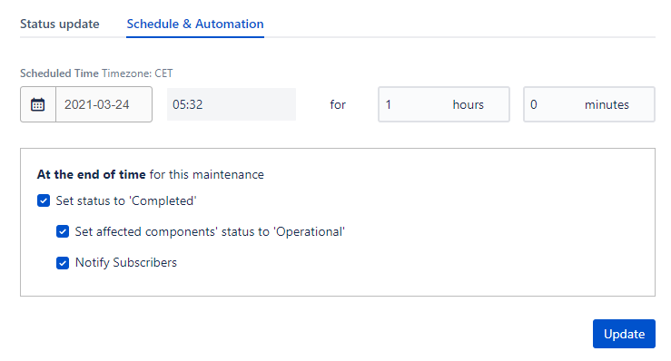
Manual update of ongoing MW (NOC may receive this request)
3. If the instruction is to extend the MW for x hrs or mins,
Go to Schedule and Automation tab, Key in new duration. DO NOT click update on this tab.
Then go to Status update tab and update message you would like to inform customer (ie: Please note that maintenance window has been extended for 1 hour). Ensure that Send notification is ticked before hitting Update button.

Slide 23
Postponing MW (NOC may receive this kind of request)
1. Go to Incident Menu → Open and Click Update on the maintenance you would like to postpone.

Slide 24
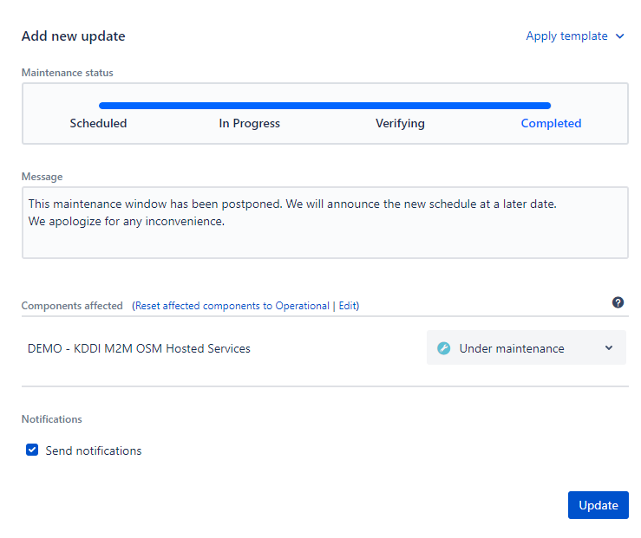

Postponing MW(NOC may receive this request)
2. Prefix the maintenance name with [POSTPONED], choose maintenance status as Completed, Update message box with below SAMPLE message, ensure that send notification is ticked before hitting Update. Notification will be triggered and components will automatically reset to Operational state.
Sample Message:
This maintenance window has been postponed. We will announce the new schedule at a later date.
We apologize for any inconvenience.

Slide 25
StatusPage Subscription Procedure
Oliver Agillon – ASIA Incident Manager
Jun 2020

Slide 26
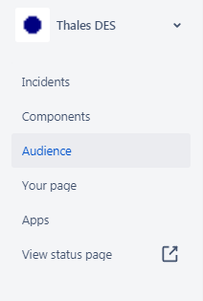
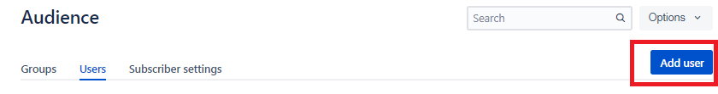
Subscription Procedure
Role: Admin (Oliver) & Team Members
Login to Statuspage admin site - https://manage.statuspage.io/login (Reminder to use @thalesgroup.com email domain).
On the side Menu, click Audience
From Audience, Go to Users Tab and Click Add User.

Slide 27
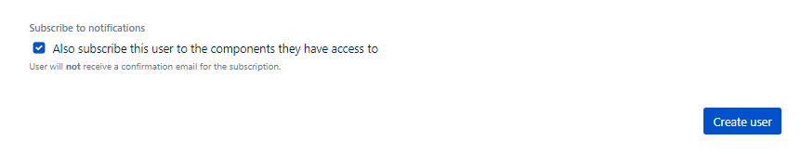
Subscription Procedure
Role: Admin (Oliver) & Team Members
Key-in Email Address, Associated groups, and tick “ Also subscribe this user to the components they have access to”. Caution: Ensure to select correct associated groups only. If unsure, ask Admin.
Click Create User to Save. Users should be able to receive an email from Statuspage requesting to set their own password.

